Slide 1
Fake News Detection Using LSTM
Deep Learning Approach with Word2Vec Embeddings

Slide 2
Project Overview

Slide 3
Objective
Develop a deep learning model to classify news as FAKE or REAL
Leverage pre-trained Word2Vec embeddings
Use LSTM architecture for sequence modeling

Slide 4
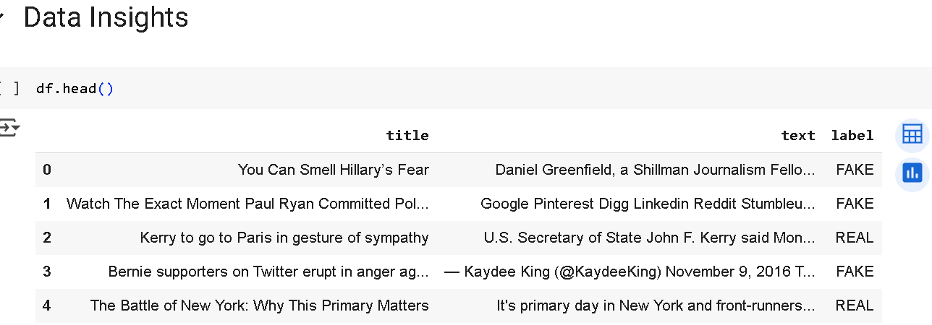
Dataset Insights

Slide 5
Dataset Summary
Total Articles: 6,335
Balanced Labels: 3,164 FAKE and 3,171 REAL
Columns: Title, Text, Label
No missing values in any field

Slide 6
Preprocessing Pipeline

Slide 7
Text Cleaning Steps
Lowercasing and punctuation removal
Stopword removal (NLTK)
Lemmatization with WordNet
Combined title + text into main_text

Slide 8
Embedding & Tokenization

Slide 9
Vectorization Details
Tokenizer with 20,000 words
Padded sequences to max length 300
Pre-trained Word2Vec (Google News, 300 dimensions)
Embedding layer set as non-trainable

Slide 10
Model Architecture

Slide 11
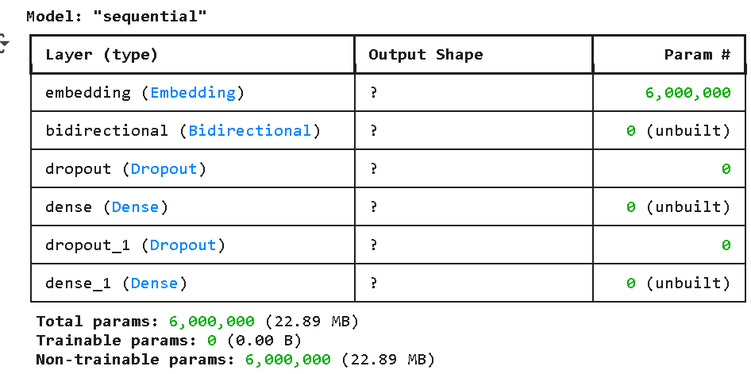
Neural Network Layers
Embedding layer (Word2Vec)
Bidirectional LSTM (64 units, dropout 0.2)
Dense layer (32 units, ReLU) + Dropout (0.3)
Output layer: Dense(1, sigmoid)

Slide 12
Training & Evaluation

Slide 13
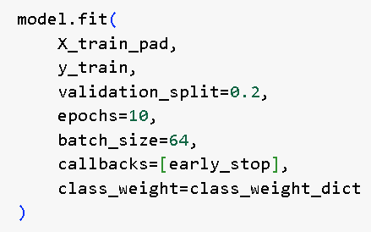
Training Configuration
Epochs: 10
Batch Size: 64
Validation Split: 20%
Early stopping and class weighting applied

Slide 14
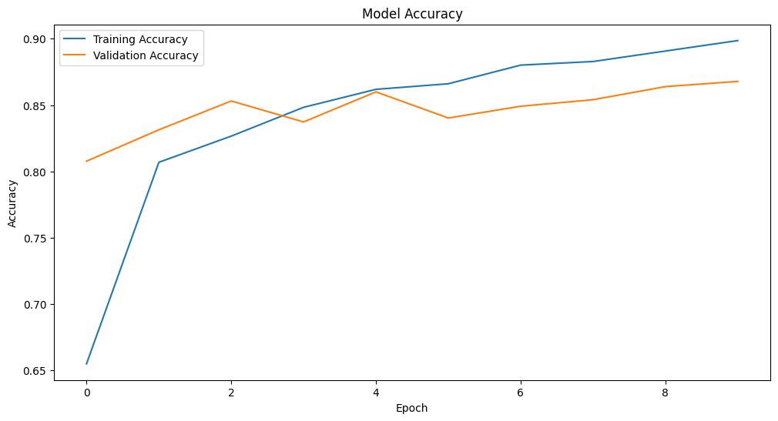
Visualizing results

Slide 15
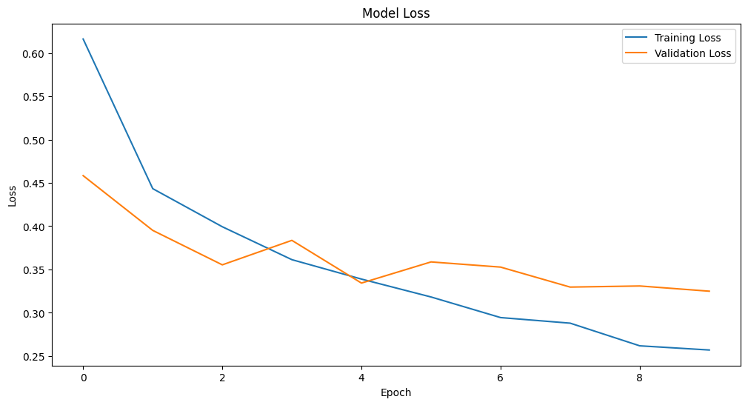
Visualizing results

Slide 16
Evaluation Metrics
Classification report (precision, recall, F1-score)
Confusion matrix generated
Threshold = 0.5 for binary classification

Slide 17
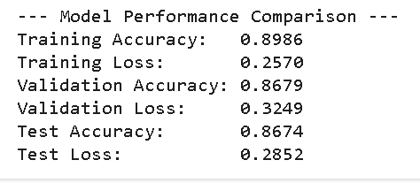
Model performance

Slide 18
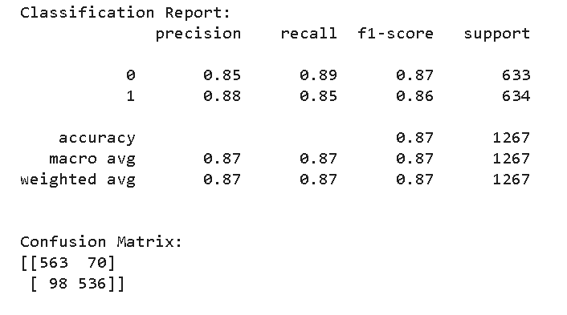
Model performance

Slide 19
Results
Precision: The model is slightly better at predicting malignant tumors (Class 1).
Recall: It detects benign tumors (Class 0) slightly more effectively.
F1-Score: Balanced performance between both classes.

Slide 20
Prediction on Unseen data

Slide 21
Conclusion & Limitation:
The model performs well with a balanced and high classification score for both tumor types.
Slight misclassification exists, especially in detecting malignant cases (98 false negatives), which is critical in medical diagnosis.
Overall, the model is reliable but could be improved further, especially to reduce false negatives.

Slide 22
Thank You

